Slide 1
LINUX DEVICE DRIVER
DAY 9 PPT
-SUBITHRA S

Slide 2
BINARY SEARCH
Initialization:
Begin with the entire sorted array.
Set two pointers: low and high, pointing to the start and end of the array respectively.
Finding the middle:
Calculate the middle index as (low + high) // 2.
Comparison:
Compare the target value with the middle element of the array.
Adjusting the search interval:
If the target matches the middle element, the search is successful.
If the target is less than the middle element, search in the lower half (adjust high).
If the target is greater, search in the upper half (adjust low).
Repeating the process:
Repeat steps 2-4 until the target is found or the search interval becomes empty.
Termination:
If the target is found, return its index.
If the search interval is empty and the target is not found, return -1.

Slide 3
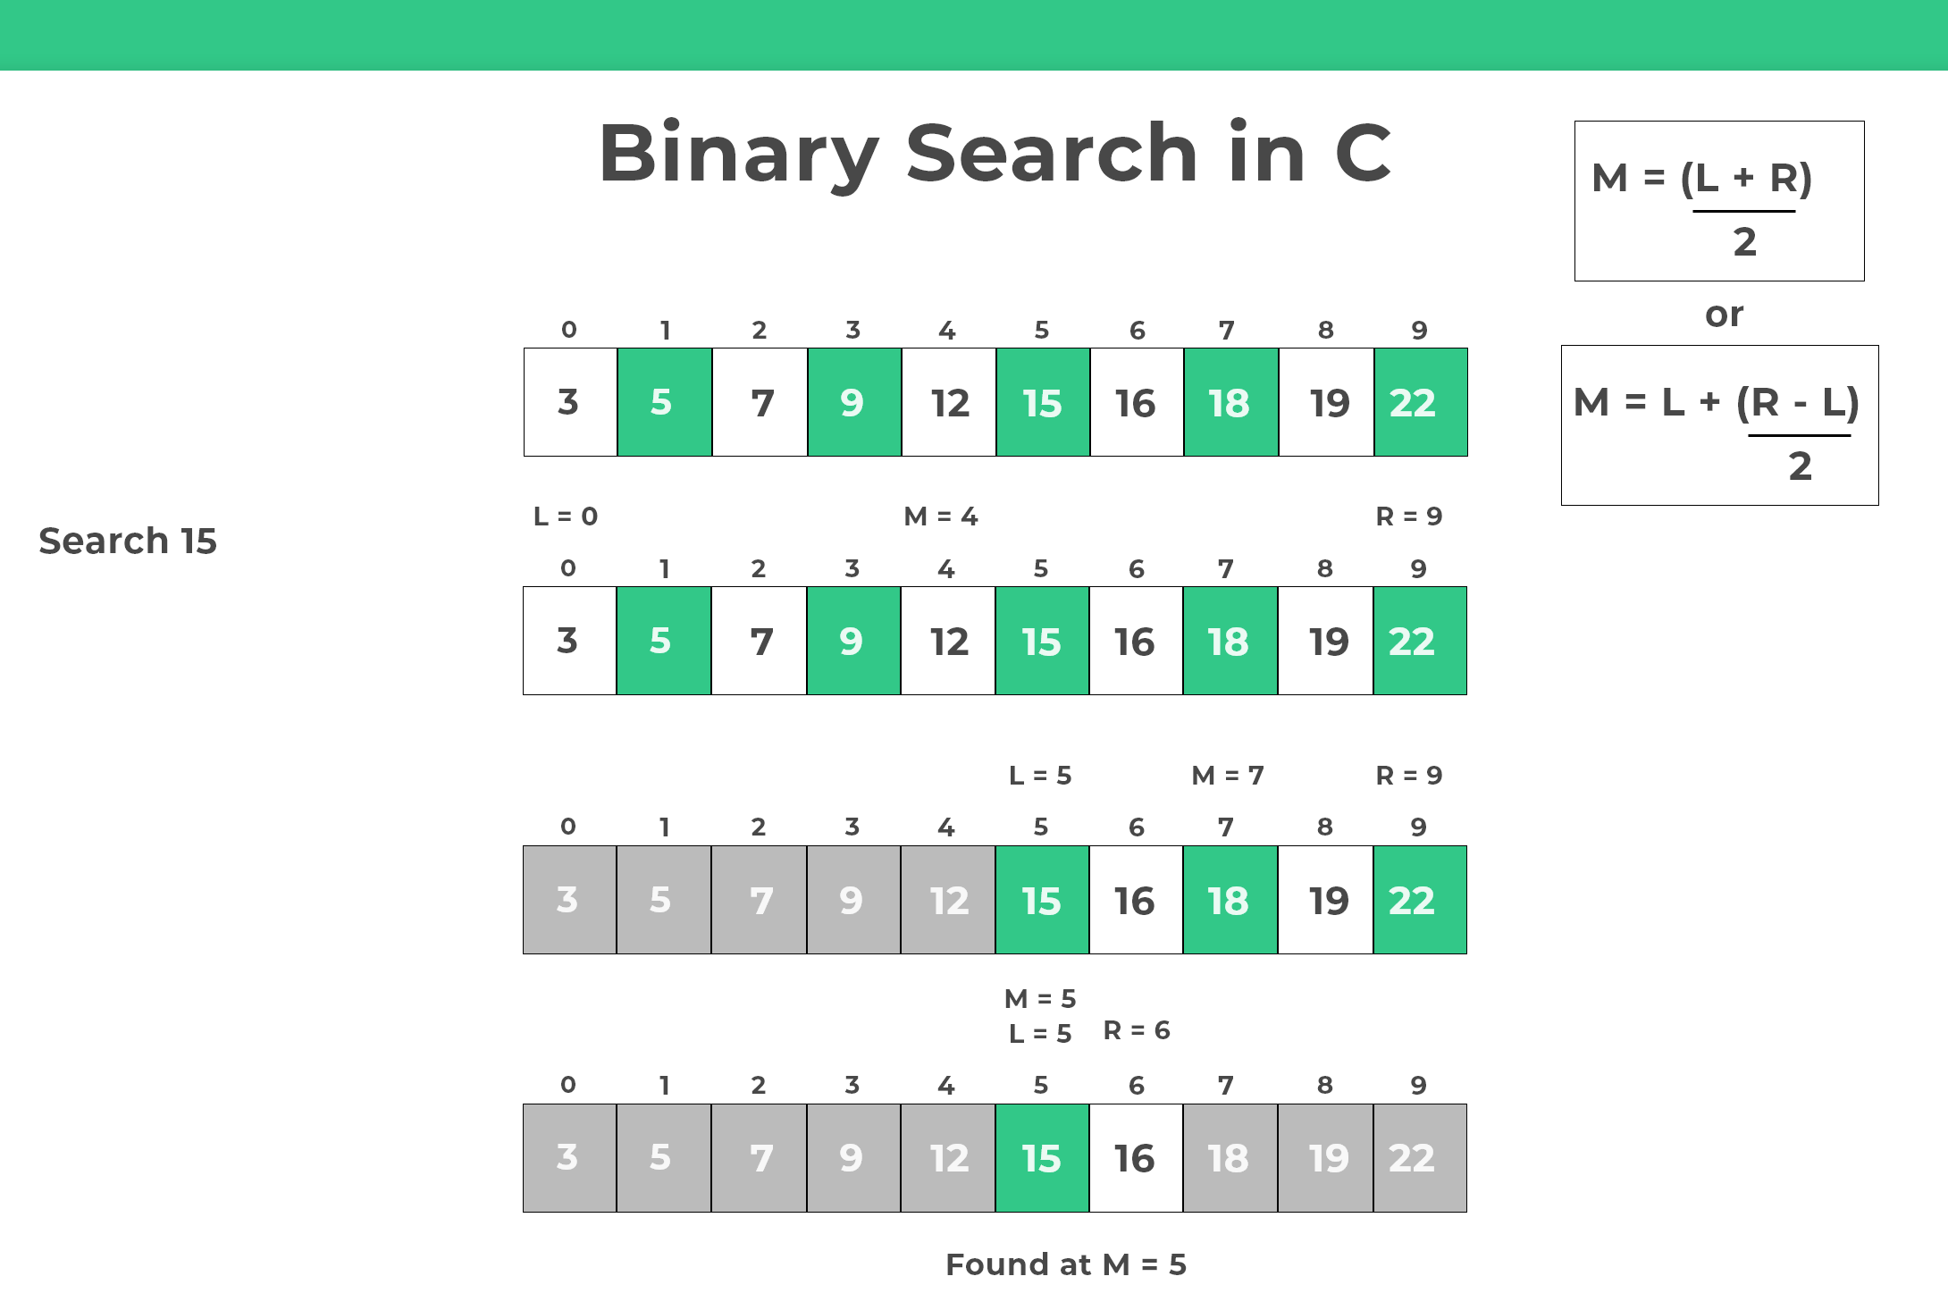

Slide 4
JUMP SEARCH
Initialization:
Begin with a sorted array and define a jump size (usually denoted as 'step').
Determining jump steps:
Calculate the jump steps by taking the square root of the array length.
For example, if the array length is 'n', the jump step would be √n.
Jumping through array:
Start from the first element of the array.
Move the current position forward by 'step' indices in each iteration.
Check if the target value is less than the current element.
If yes, perform linear search between the previous jump index and the current index.
Linear search:
Perform linear search within the current block for the target value.
If the target value is found, return its index.
If the end of the array is reached without finding the target value, return -1.
Repeat or terminate:
Repeat steps 3-4 until the target value is found or the current element exceeds the array length.
If the target value is found, return its index.
If the current element exceeds the array length, the target value is not present in the array.

Slide 5
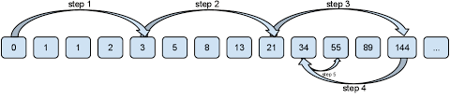

Slide 6
MACRO
Macros in C are preprocessor directives that allow for simple text substitution in the source code before compilation.
They are defined using the #define directive.
SYNTAX:
#define MACRO_NAME value

Slide 7
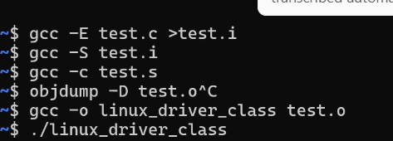
DEBUGGING

Slide 8
THANK YOU

